Slide 1
Process Scheduling Algorithms

Slide 2
Scheduler
A scheduler is an operating system program that selects the next job to be admitted for execution
Performance criteria to maximize the system performance:
Throughput :- Maximum number of processes served per unit time. It must be high.
CPU Utilization :- CPU must be busy for maximum time.
Turnaround Time :- Turnaround time is the time from process submission to completion of process.
Turnaround Time = Finish Time – Arrival Time

Slide 3
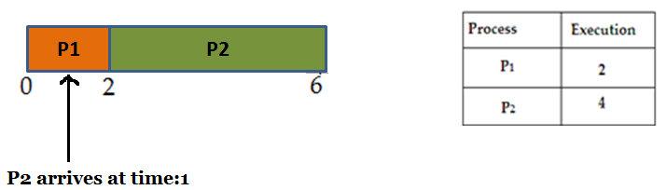
4) Waiting Time :- The time from the submission of process to start of execution. It should be minimum.
Waiting Time = Turnaround Time – CPU Time
CPU time = Burst time = Execution time = Process time

Slide 4
5) Response Time :- It is the time from the submission of a request until the first response is produced.
6) Priority :- The scheduler should favour higher priority process.
7. Average Turnaround Time =
(Turnaround time of all process) / (Total number of process)
8. Average waiting Time =
(Waiting time of all processes) / (Total number of process)
9. Average Response Time =
( Response time of all process) / (Total number of processes)

Slide 5
Pre-emptive & Non-Pre-emptive
The Scheduling policy determines when it is time for process to be removed from the CPU and which ready process should be allocated to the CPU next.
CPU scheduling is divided into two types:
Preemptive Scheduling:
It interrupts the processing of a process and transfers the CPU to another process.
Non Preemptive Scheduling:
Uninterrupted completion of process execution. Once the system has assigned a processor to a process, the system cannot remove that processor from the process.

Slide 6

First Come First Serve (FCFS)
It is non-preemptive scheduler. Jobs are executed in order of their arrival.

Slide 7
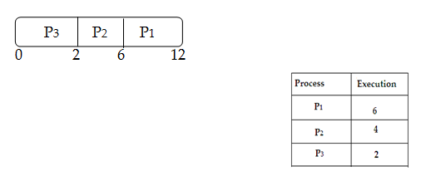
Shortest Job First (SJF) (Pre-em/Non-Pre-emp)
In SJF, the process with smallest burst time is selected first for execution (provided it has arrived).
If two processes have the same CPU time, FCFS is used.

Slide 8
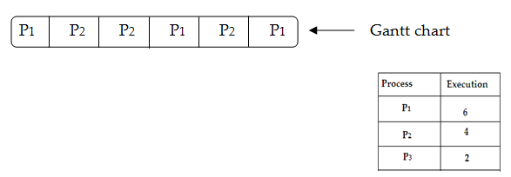
Round Robin Scheduling (RR)
In RR, the CPU time is divided in slices of time (Quantum time). Each process is given one time slice for which CPU is allocated to that process for execution.
For example, time slice = 2

Slide 9
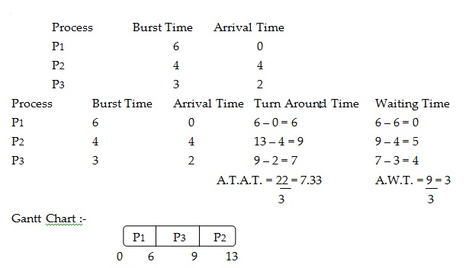
Calculate average waiting time, average turnaround time if the processes are scheduled using FCFS:

Slide 10
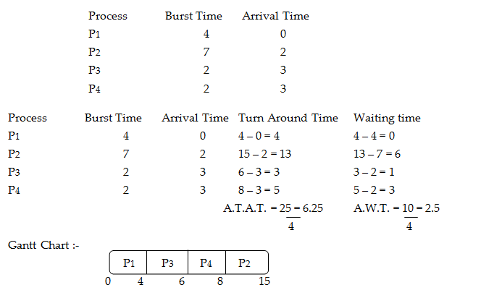
Consider the following process where the arrival and burst time are given below & calculate average waiting time and turnaround time using pre-emp SJF

Slide 11
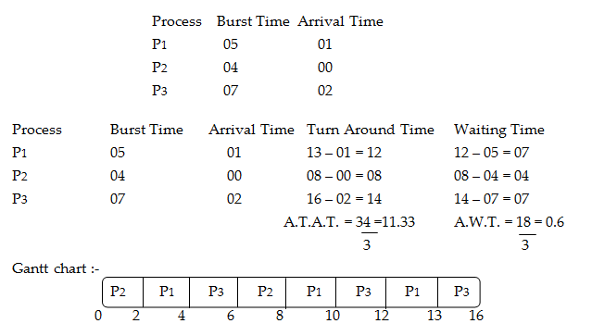
Calculate average waiting time and average turnaround time using Round Robin algorithm, if Quantum time is 2 :

Slide 12
Priority Scheduling
Priority Scheduling is a method of scheduling processes that is based on priority.
The processes with higher priority should be executed first, whereas jobs with equal priorities are carried out on a round-robin or FCFS basis.
Preemptive Priority Scheduling:
The processes are mostly assigned with their priorities.
Sometimes it is important to run a task with a higher priority before another lower priority task, even if the lower priority task is still running.
So, the lower priority task holds for some time and it again resumes only when the higher priority task finishes its execution.

Slide 13
Non-Preemptive Priority Scheduling:
In this type of scheduling method, once the CPU has been allocated to a specific process, it is not revoked even if any higher priority process arrives in between.
Next higher priority process is picked for execution once the previous process is executed completely
Lower the number, higher is the priority.

Slide 14
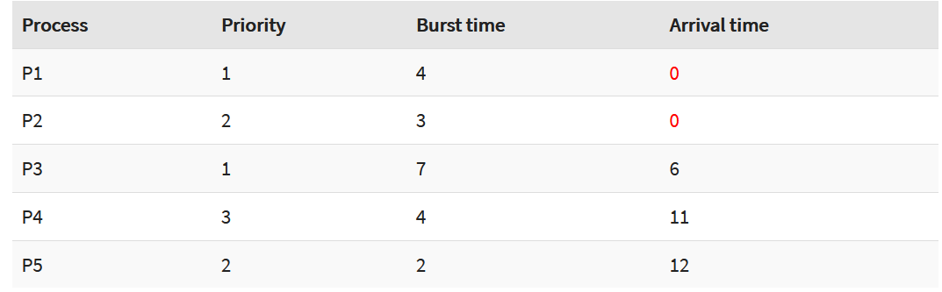
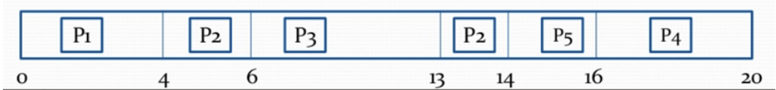
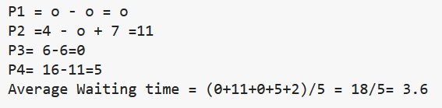
Example, Preemptive Priority Scheduling:

